Slide 1
System and Core Network Aspects
Erik Guttman 3GPP TSG SA Chairman Samsung R&D Institute UK

Slide 2
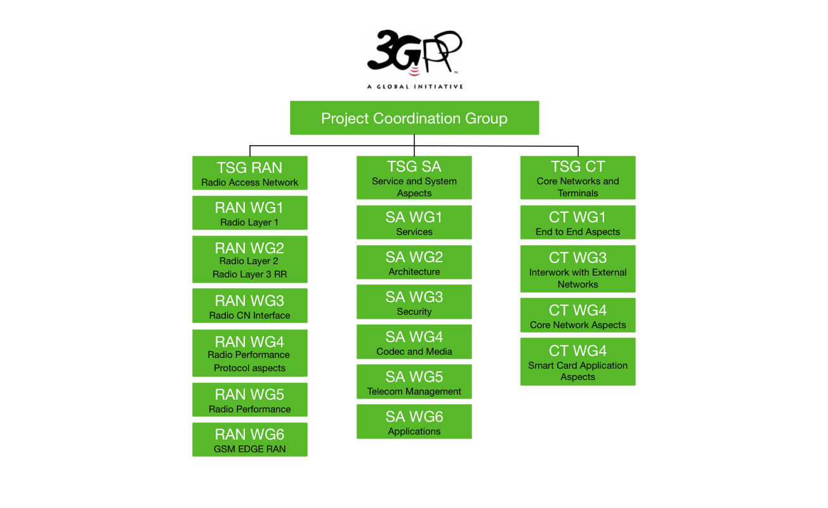

Slide 3
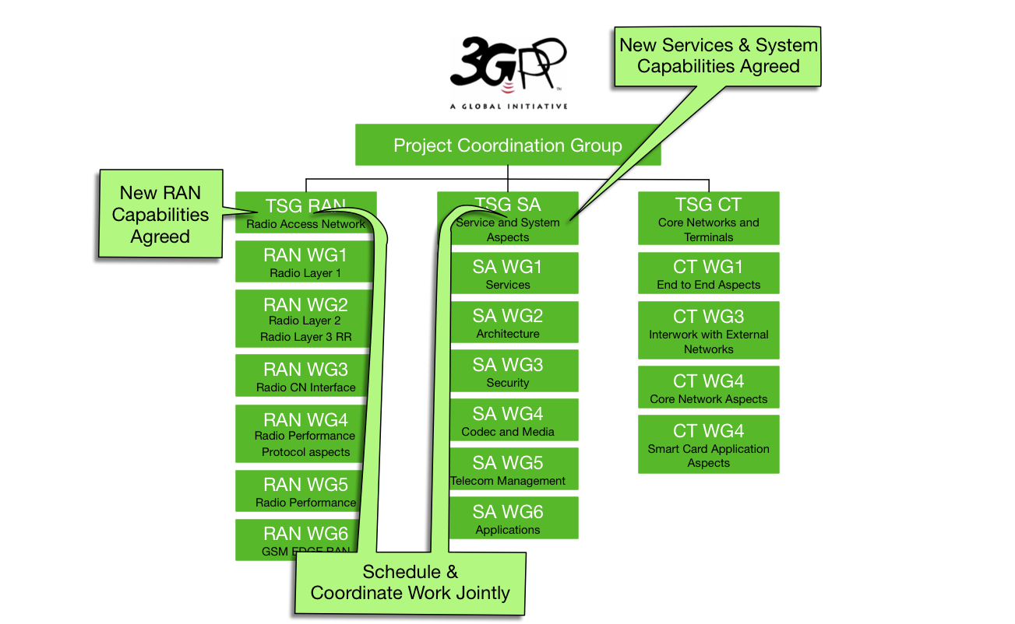

Slide 4
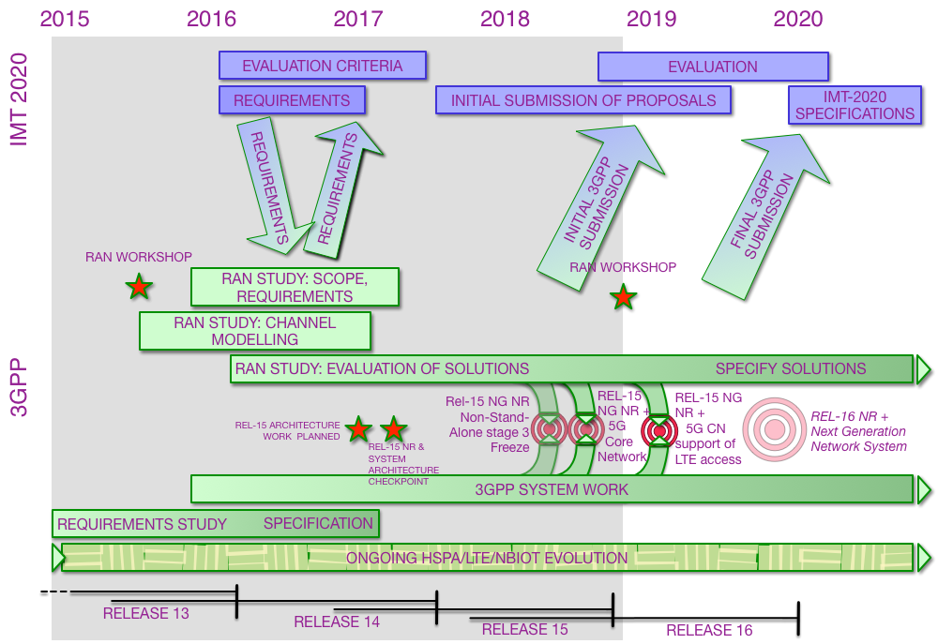

Slide 5
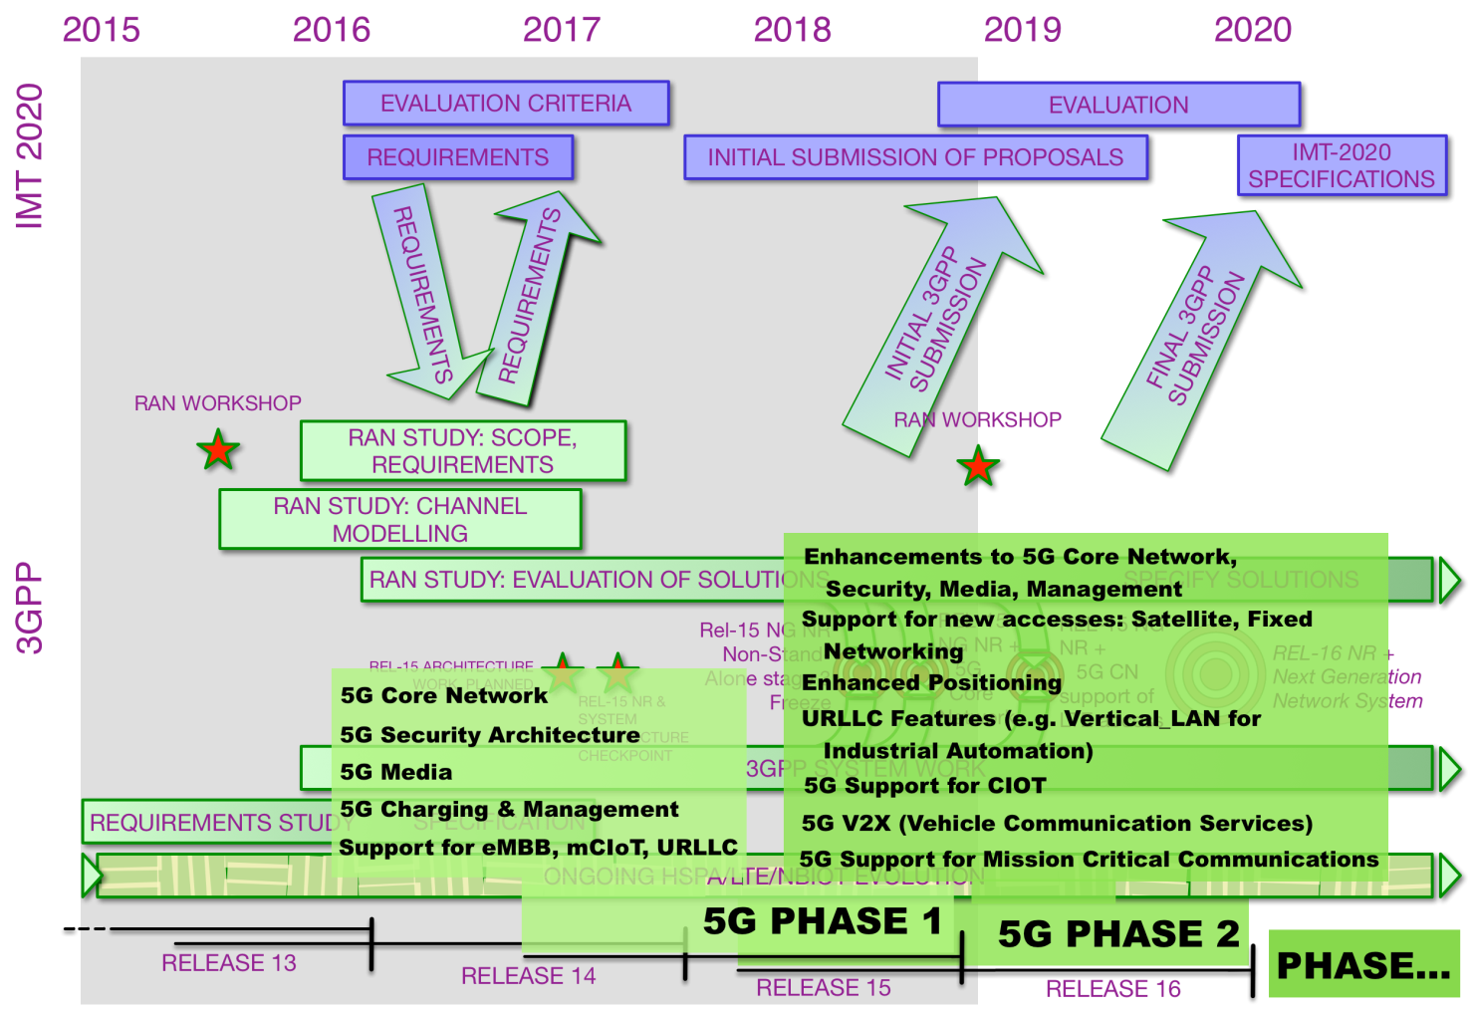

Slide 6
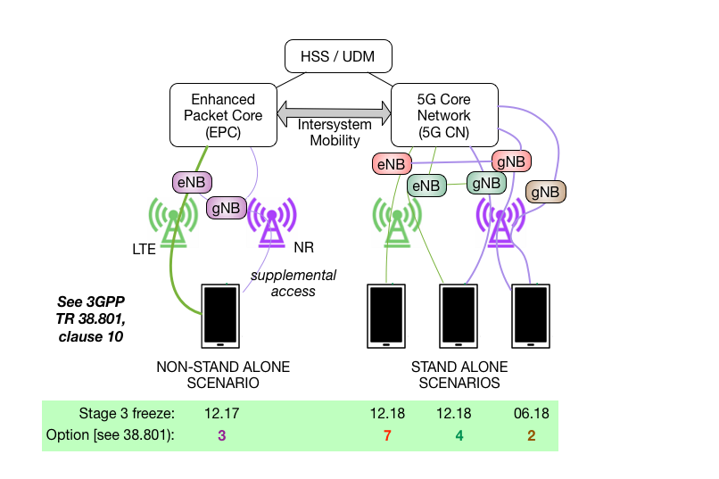
5G Deployment Scenarios

Slide 7
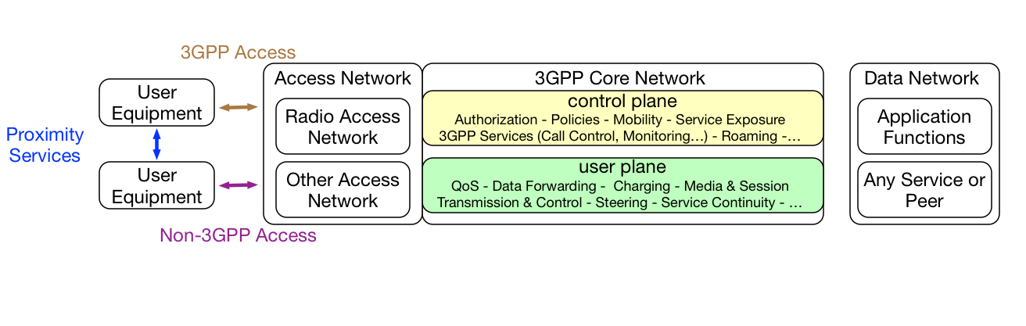
3GPP System

Slide 8
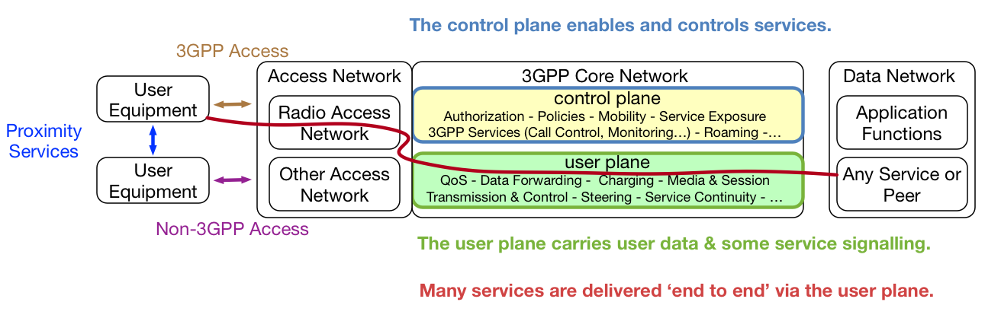
3GPP System

Slide 9


Software- and Service-centric Transformation
One CoreNetwork fits all → Open & Flexible Enabler
Telecom Operators → Multiple Stakeholders
Phones → Things
Procedures → Services
Static Topology → On-demand Resources
Dedicated Hardware → Orchestrated Resources
Network Function → Virtualization
Single Network → Slice
4G

Slide 10


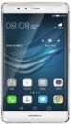







5G System Service Perspective
Smart City
Automotive
Healthcare
Factory Control
Agriculture
A
P
I
Internet
NB-IoT
Enterprise
LTE
H
A
R
D
W
A
R
E

Slide 11
5G Core Technologies
Orchestration and Virtualization (NFV) – de-couple logical function from hardware
Slicing – logical end-2-end networks tailed to customer needs
Edge Computing (MEC) – resources where they are needed (URLLC)
Exposure (API) – 3rd party access to 5G services
Service Based Architecture (SBA) – stateless, open, flexible
Harmonized Protocols & Access Agnostic – generic solutions

Slide 12
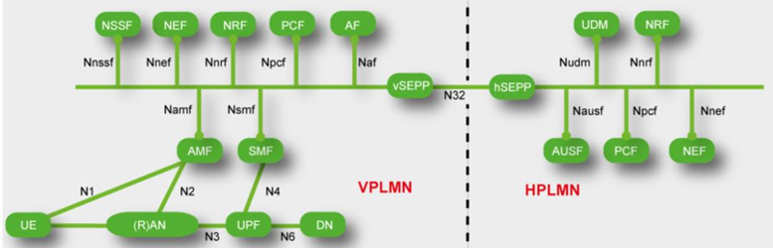
Control Plane Feature – Service Based Architecture
Each NF as a combination of mono-functional NF services.
NFs provide and consume services to and from each other using a unified protocol.
Stateless NF was specified for AMF.
In Rel-16 NF service granularity will diminish and more NFs will become stateless.

Slide 13

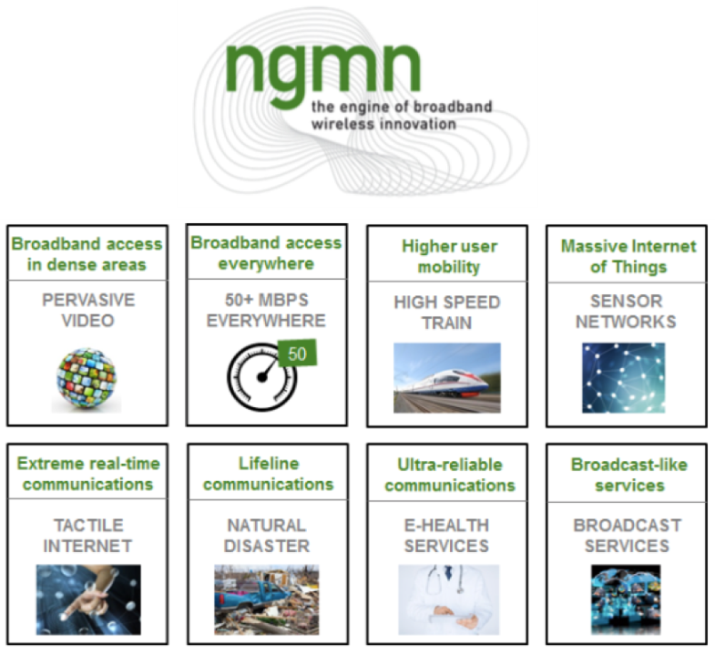
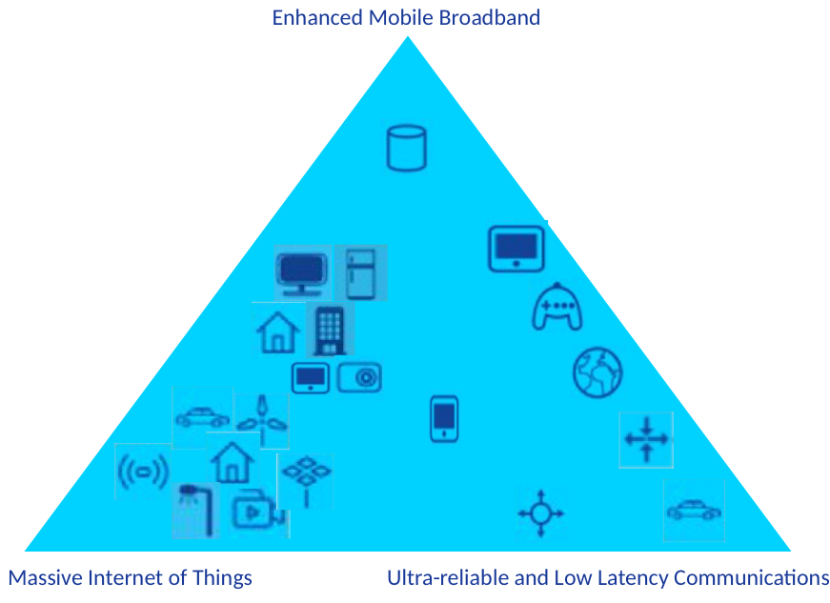
5G / IMT-2020 VISION
● Address demands and business contexts of 2020 and beyond. ● Enable a fully mobile and connected society.
● Empower socio-economic transformations in countless ways.

Slide 14
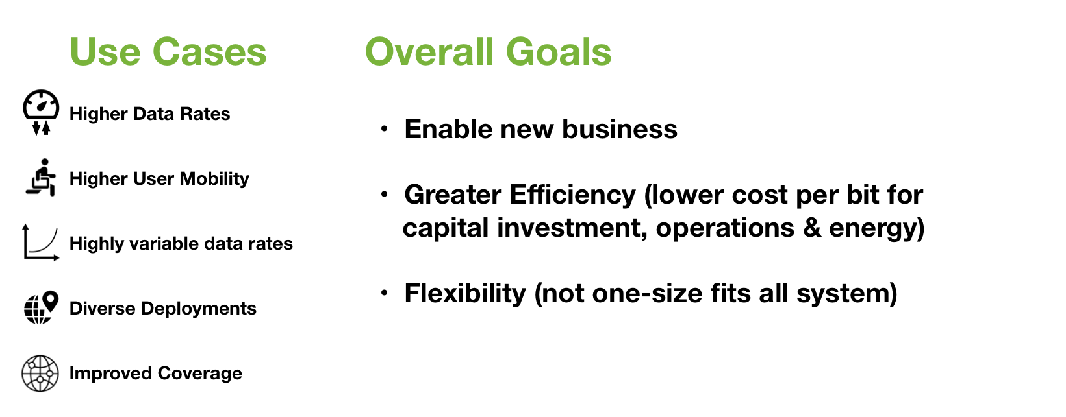
Enhanced Mobile Broadband

Slide 15
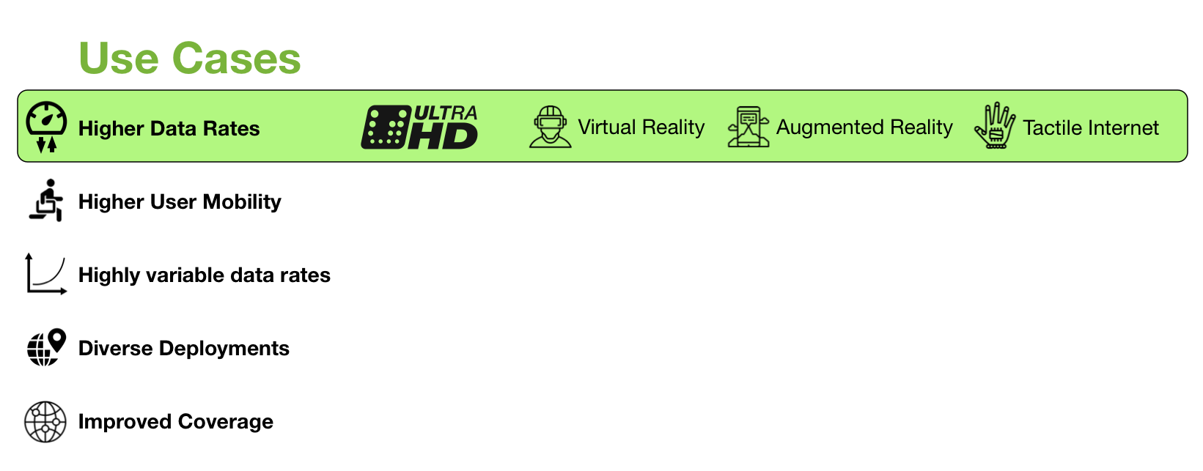
Enhanced Mobile Broadband

Slide 16
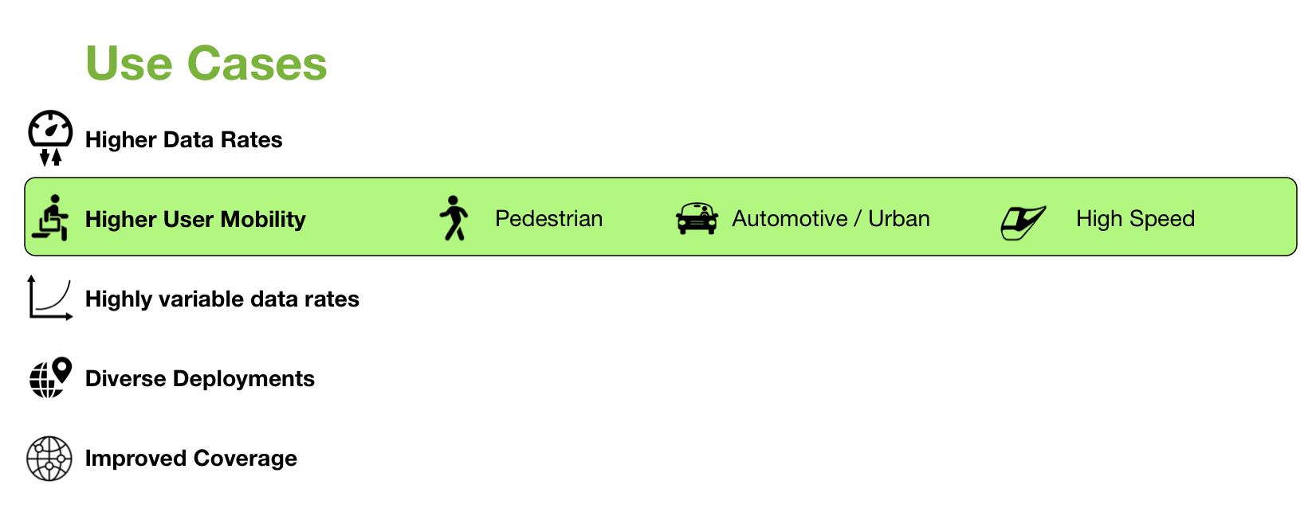
Enhanced Mobile Broadband

Slide 17
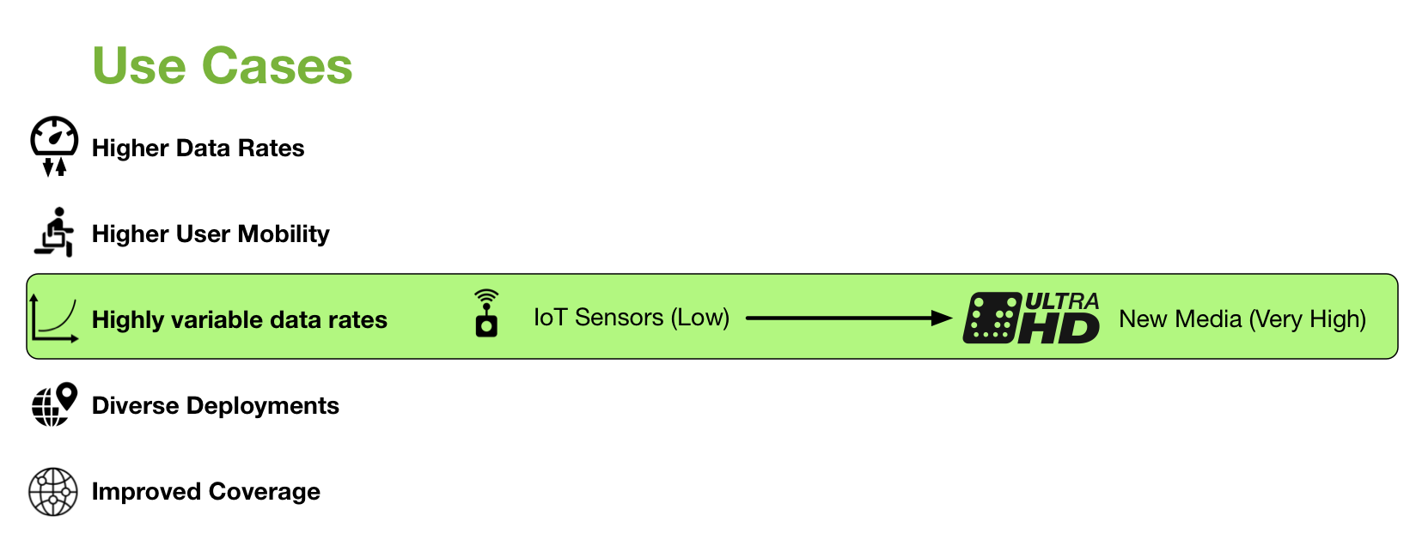
Enhanced Mobile Broadband

Slide 18
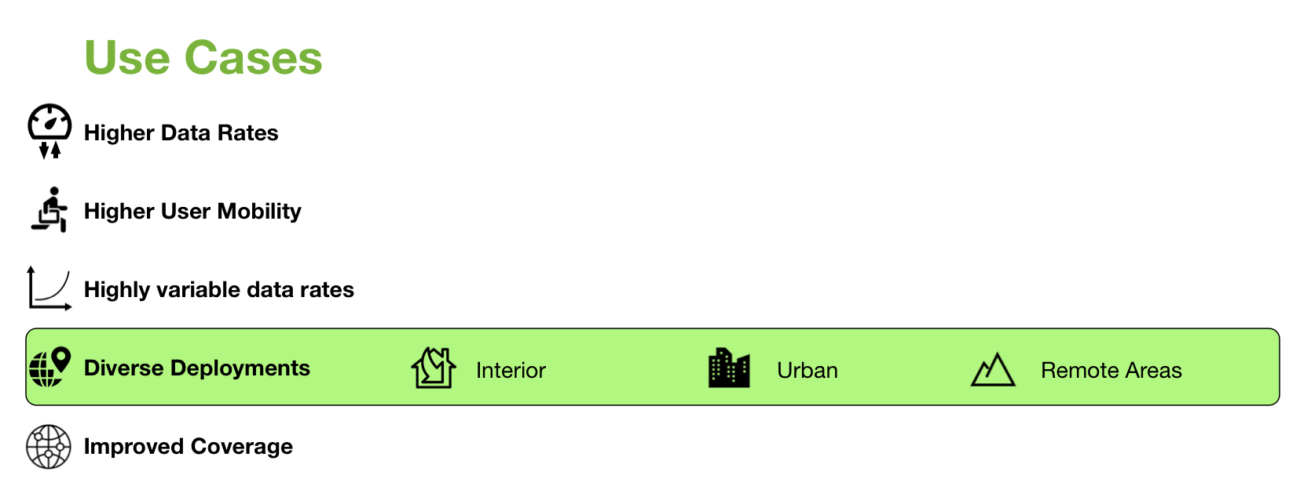
Enhanced Mobile Broadband

Slide 19
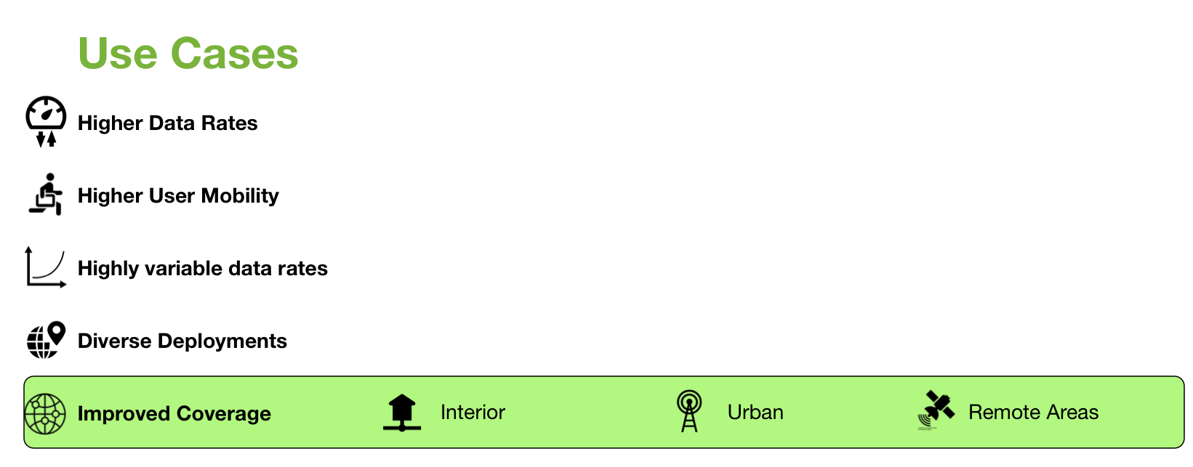
Enhanced Mobile Broadband

Slide 20
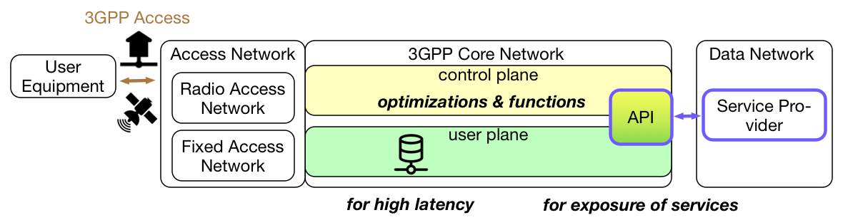
Enablers of 5G eMBB
Specific enhancements of the user plane
Small / infrequent data communication, high latency communication, power savings mode…
Exposure Functions, APIs, Common API Framework – to enable external interworking with 3GPP.
Support for diverse deployments, improved coverage
Control and operation support small cell deployments
New 3GPP accesses: wire line-wireless convergence, satellite access
Improved QoS model: Packet flows & related policies

Slide 21
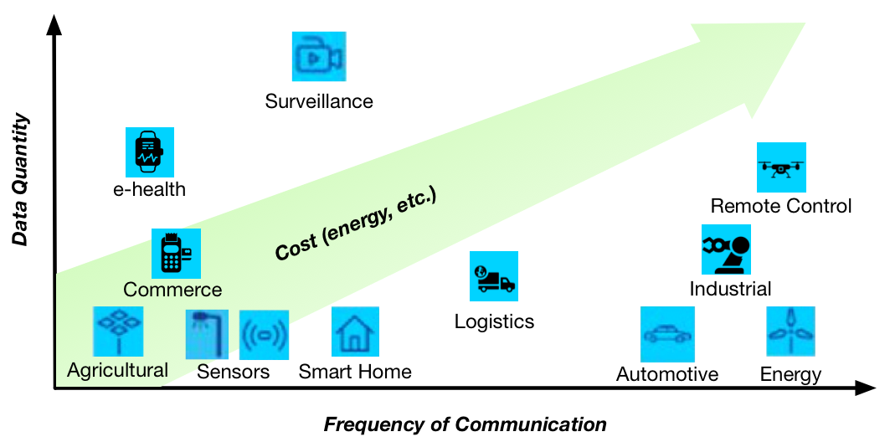
Massive Internet of Things
Much greater variety of service compared with existing 4G network

Slide 22
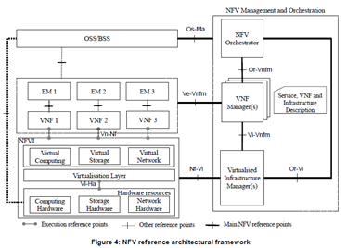
Massive Internet of Things
Enablers of mIoT
Network virtualization and Orchestration
Network automation enables MNO to provide NW services much faster than existing system ->TTM for customers
NFV enables OPEX reduction by network automation ->Enables automated service with selected NW functions based on SLA (with NW slicing)
Source: ETSI GS NFV 002 V1.2.1

Slide 23

Ultra-reliable and Low Latency Communications
Examples of Use cases to be covered by 3GPP 5G system
Ultra-reliable
Low Latency
Factory of the future
eHealth
Building automation
Connected car
Smart city
Electrical power distribution
Rail-bound mass transit
Factory of the future
eHealth
Building automation
Connected car
Smart city
AR/VR
Program Making and Special Events
Both aspects are critical for a lot of use cases.

Slide 24





Ultra-reliable and Low Latency Communications
Enablers of URLLC
The Internet
5GCN
Network slicing
Resource isolation from other service ->No service impact caused by other slices failure
Customized NW functions and/or capacities to ensure SLA
Slice for eMBB
Session Management Function dedicated for the slice
U-plane Function dedicated for the slice
NR
Shared NW Function among slices
Session Management Function dedicated for the slice
Slice for Ultra-reliable
U-plane Function dedicated for the slice
Ultra-reliable service NW

Slide 25
Ultra-reliable and Low Latency Communications
Enablers of URLLC
Edge Computing
Applications can be hosted at “Edge-side” ->Low Latency compared with centralized manner
Centralized NC
The Internet
UE
gNB
U-Plane Function
Local
UPF
Edge Cloud

Slide 26


For more Information:
info@3gpp.org
Erik.Guttman@samsung.com
you-nakano@kddi.com
www.3gpp.org
Search for WIDs at http://www.3gpp.org/specifications/work-plan and http://www.3gpp.org/ftp/Information/WORK_PLAN/ (See excel sheet)

Slide 27
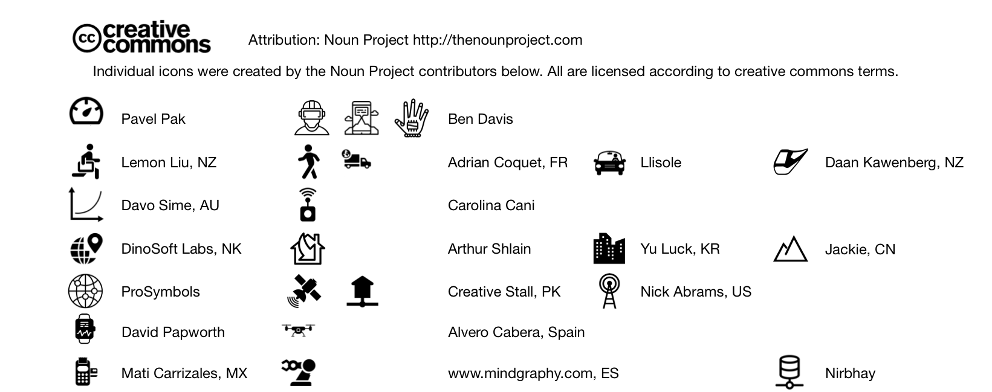
Attributions for images in presentation

